Slide 1

Face Detection by Aggregating Visible Components
Jiali Duan, Shengcai Liao, Xiaoyuan Guo, and Stan Z. Li
Center for Biometrics and Security Research
Institute of Automation, Chinese Academy of Sciences

Slide 2
Introduction
Unconstrained face detection:
Illumination changes
Large pose variations
Occlusions
Notes:
Unconstrained face detection is challenging due to pose and illumination variations, occlusions, blur, etc.
While illumination variations are handled relatively better due to many physical models, pose variations and occlusions are the
most commonly encountered problems in practice.
2. Many approaches have been
specifically proposed to solve pose variations and occlusions, however, few of them addresses pose variations and occlusions in a model explicitly and
simultaneously.

Slide 3
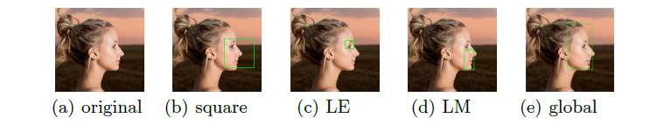
Motivations:
Notes:
The intuition behind our component-based design is the fact that face images
in real-world applications are often with large pose variations and occlusions.
1. Consider for example, a face turning left over 60 degrees (see Fig. 2(a)), where the
holistic face detector unavoidably includes unwanted backgrounds (see Fig. 2(b)).
However, a robust face detector should not only predict the number of faces but also give bounding boxes as tight as possible.
2. It's observed that although a face with large rotation towards left may lead to left eye invisible, we can still, under this circumstance, locate the right eye
or mouth and nose etc.
3. It also applies to occlusions where for example, the left half face is occluded by another person's shoulder, we can still locate the whole
face by the detection of right eye.

Slide 4
Drawbacks of Existing Approaches
Pose variations and occlusions are still the most encountered problems in practice
2. Explicit modeling in face detection is still required and more effective
Pure data driven solutions -> complex and slow
Notes:
Many approaches have been specically proposed to solve pose variations and occlusions, however, few of them addresses pose variations and occlusions in a model explicitly and simultaneously
2. Data driven solutions such as CNN may be good in dealing with various face variations, however, they usually result in very complex models that run slowly, which limits their application in practice, especially in embedding devices.

Slide 5
Contributions
1. Address pose variations and occlusions in face detection explicitly and simultaneously
Single framework with low complexity
2. Pose-invariant Component Mapping
More robust to pose-variations
3. Local to global aggregation
Alleviate false alarms
Notes:
1. In this paper, we propose a novel face detection method called Aggregating Visible Components (AVC), which addresses pose variations and occlusions simultaneously in a single framework with low complexity.
2. Mapped from meanshape through component invariant mapping, the proposed component detector is more robust to pose-variations
3. A local to global aggregation strategy that involves region competition helps alleviate false alarms while enhancing localization accuracy

Slide 6
Related Works
For occlusions: NPD [1]
For pose variations: Faceness [2]
3. For explicit modeling: DPM based [3]
[1] Liao, S., Jain, A., Li, S.: A fast and accurate unconstrained face detector. IEEE transactions on pattern analysis and machine intelligence 38 (2016) 211-223
[2] Yang, S., Luo, P., Loy, C.C., Tang, X.: From facial parts responses to face detection: A deep learning approach. In: Proceedings of the IEEE International Conference on Computer Vision. (2015) 3676-3684
[3] Yan, J., Lei, Z., Wen, L., Li, S.: The fastest deformable part model for object detection. In: Proceedings of the IEEE Conference on Computer Vision and Pattern Recognition. (2014) 2497-2504
Notes:
Liao et al proposed to learn features in deep quadratic trees, where dierent views could be automatically partitioned.
2. Yang et al. [13] proposed a specific architecture called Faceness-Net, which considers faceness scoring in generic object proposal windows based on facial component responses and their spatial conguration, so that face detection with occlusions can be explicitly handled.
3. DPM describes an object by a non-rigid constellation of parts and jointly optimize parameters whereas we learn component detectors independently and apply an aggregation strategy to constitute a global representation.

Slide 7

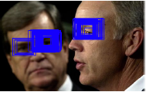
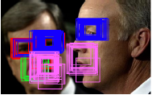
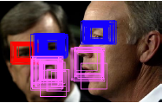
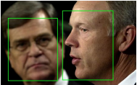
Pipeline
Input Image
LE detection
LM detection
Competition
Aggregation
Notes:
It includes three main steps in the detectin phase: visible component detection step, local region competition step, and the local to global aggregation step.
PPT: first: input image second: LE detection third: LE and LM components, achieved via symmetric component detection forth: local competition step fifth: local to global aggregation
2. AVC works by detecting only the visible components which would be later aggregated to
represent the whole face.
3. Two half-view facial component detectors are trained, and for this we introduce a pose-invariant component definition via a regression
based local landmark alignment, which is crucial for training sample cropping and pose-invariant component detection.
4. Then the two learned detectors are mirrored to detect the other half view of the facial components.
5. Next, the detected visible facial components go through a local region competition module to alleviate false detections, and nally a local to global aggregation strategy is
applied to detect the whole face adaptively.

Slide 8
Component-invariant mapping
Motivations:
Facial part training samples for Profile and Semi-profile Views ?
Notes:
As was indicated in AFLW [30], although there is largely an agreement on how to dene anchor points and extents of rectangle for frontal faces, it's not so obvious for pro le and semi-profile views, which makes it harder to get consistently annotated samples for training.

Slide 9

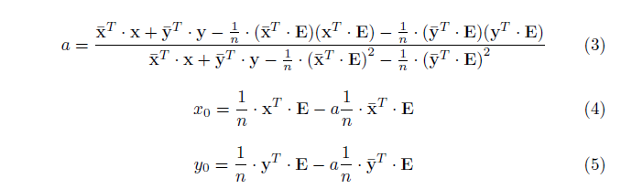
Math Definition:
Notes:
Samples in AFLW consist of 21 landmarks. We first calculate the mean shape of the whole database with samples normalized and missing coordinates excluded.
2. Region in the mean shape which we want to map ie. left eyebrow and left eye for LE component is mapped directly to a new input sample by applying the transformation (1,2)
3. Note that in (1) and (2) x and y are vectors representing x coordinates and y coordinates of mean shape while x and y representing those of a new sample. E is a nx1 vector with all elements being 1, x0; y0 are scalars that denote osets and n is the number of landmarks used for regression.
4. Closed form solution can be derived as (3) and (4)

Slide 10
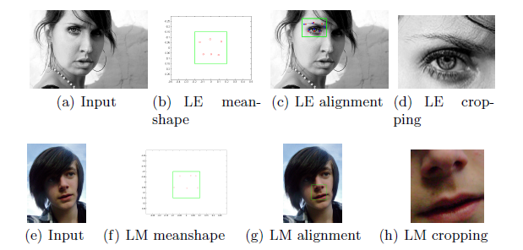
Visual Interpretation
Notes:
An intuitive visual interpretation is shown:
1. blue points are annotated landmarks while red points are mapped from meanshape.
2. Positive samples extracted in this way retain excellent uniformity, which would be used for training LE and LM component detector
3. The pose-invariant component mapping method is also used for preparing negative samples for bootstrapping

Slide 11
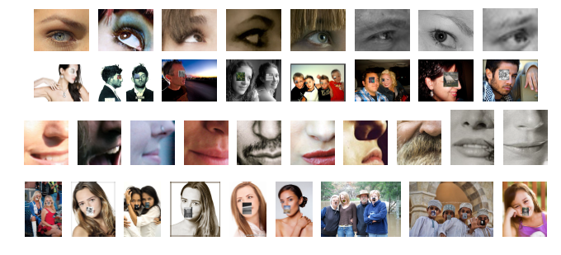
1st and 3rd row: training samples
2nd and 4th row: negative bootstrapping samples

Slide 12
Why LE and LM ?
Local landmarks regression
Invariance throughout the database
Why 6 landmarks ?
2. Examples
Notes:
why not eyes, noses or other patches?
Our motivations are:
These patches are not dened arbitrarily or conceptually but based on the regression of local
landmarks. As in Fig 3, these landmarks are derived by LE/LM meanshape of AFLW to ensure that they retain invariance throughout the database
Why 6 landmarks instead of 3 or 9?
According to AFLW, a nose is defined by 3 landmarks, the width/height of these patches would then be too small for
training and testing. While 9 landmarks would result with a facial area too broad thus vulnerable for occlusions.

Slide 13
Training procedure
Feature: NPD [1]
Training framework:
Deep Quadratic Tree [1] classifier
Soft-Cascade + hard-negative mining
[1] Liao, S., Jain, A., Li, S.: A fast and accurate unconstrained face detector. IEEE transactions on pattern analysis and machine intelligence 38 (2016) 211-223
Notes:
We choose NPD as our feature mainly for its two properties: illumination invariant and fast in speed because each computation involves only two pixels.
With the scale-invariance property of NPD, the facial
component detector is expected to be robust against illumination changes which
is important in practice.
2. The Deep Quadratic Tree (DQT) [23] is used as weak classier which learns two thresholds and is deeper compared to typical tree classifiers
Soft-Cascade [31] as well as hard-negative mining are applied for cascade training.
3. While individual NPD features may be "weak", the Gentle AdaBoost algorithm is utilized to learn a subset of NPD features organized in
DQT for stronger discriminative ability.

Slide 14
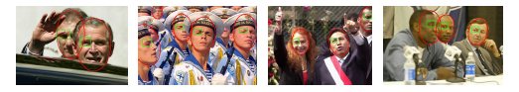
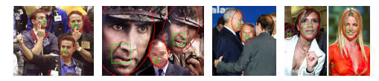
Example outputs of LE and LM
Notes:
This figure shows some example outputs by LE and LM detector respectively. As can be seen, our component-based detector has the inherent advantages under occasions of occlusions (the first and last picture)
and pose-variations (the 4th and 7th ), where a holistic detector would normally fail.

Slide 15
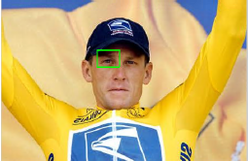
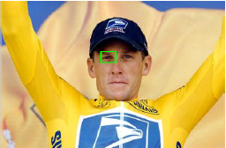
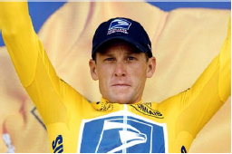

Symmetric Component Detection
Notes:
The detection of right eyebrow + right eye (RE)
and right mouth + right nose (RM) can be achieved by deploying the detector
of their left counterpart. From left to right of the above figure illustrates how we locate RM and
RE using the same detectors as LM and LE.

Slide 16
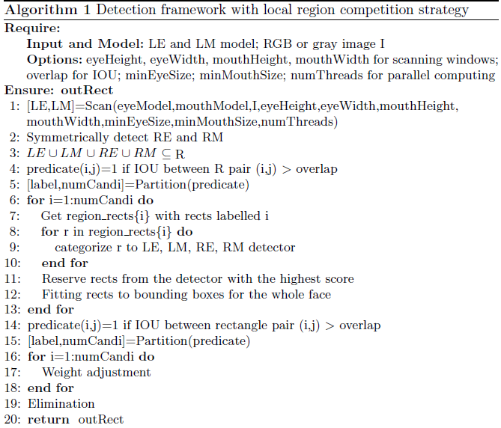
Aggregation Strategy
Core idea:
1. Reject false alarms
during merging (compete)
2. Improve localization accuracy during aggregation (collaborate)
Notes:
We use rectangle as facial representation. Note that our proposed pipeline also applies to elliptical representation as the aforementioned work flow remains unchanged. Line 6 to line 11 first obtains candidate outputs of a specic facial region by LE, RE, LM, RM facial part detectors denoted as region rects
Line 12, winning rectangles from each are regressed directly to bounding boxes.
This is a local to global bottom up strategy because rects of different facial regions are mapped to global facial representations
4. Note that we only learn two sets of regression parameters (linear regression), because during inference the coordinates of RE/RM component are rst mirrored, regressed and then mirrored back, using the same parameters of their left counterparts.
5. Line 15, these rects are then concatenated for partitioning using disjoint-set algorithm.
6. Then the locations of partitioned rects are translated and adjusted by tuning their widths and heights according to their confidence scores (weights).
7. Finally, NMS is deployed to eliminate interior rects.

Slide 17
Evaluation
AFW [1]
FDDB [2]
[1] Zhu, X., Ramanan, D.: Face detection, pose estimation, and landmark localization in the wild. In: Computer Vision and Pattern Recognition (CVPR), 2012 IEEE Conference on, IEEE (2012) 2879-2886
[2] Jain, V., Learned-Miller, E.G.: Fddb: A benchmark for face detection in unconstrained settings. UMass Amherst Technical Report (2010)
Notes:
Annotated Faces in the Wild (AFW) [18] contains 205 images collected from Flickr that contain images of cluttered scenes and dierent viewpoints.
2. Face Detection Data Set and Benchmark (FDDB) [1] contains 2845 images with 5171 faces, with a wide range of arbitrary poses, occlusions, illumination changes and resolutions.

Slide 18
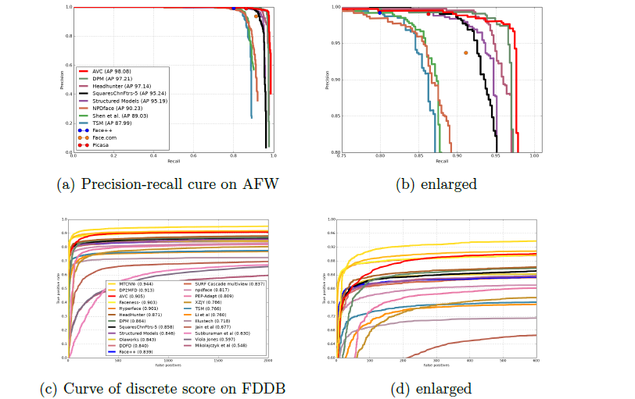
Model Complexity between AVC and NPD
Notes:
To evaluate on AFW, we t winning rects from local component detectors to rectangle representations of the whole face, which would be used for further aggregation.
2. We compare AVC with both academic methods like DPM, HeadHunter, Structured Models and commercial systems like Face++ and Picasa.
3. AVC outperforms DPM and is superior or equal to Face++ and Google Picasa. The precision of AVC is 98.68% with a recall of 97.13%, and the AP of AVC is 98.08%
4. As FDDB uses ellipse for annotations, we map the output rectangles to elliptical representations of the whole face.
5. Ours performs worse than MTCNN and DP2MFD which resort to powerful yet complex CN- N features but is better than Faceness-Net, which is also component-based but with the help of CNN structure.
6. AVC gets 84.4% detection rate at FP=100, and a detection rate of 89.0% at FP=300.

Slide 19
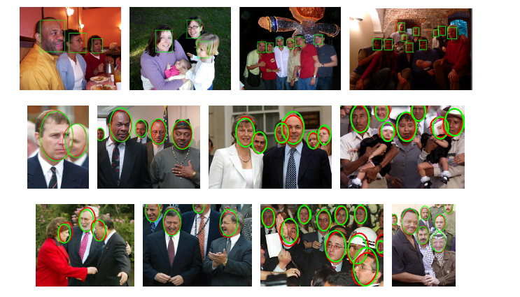
Results on AFW and FDDB
Notes:
1. Qualitative results of AVC on AFW (first row using rectangle representations) and FDDB (second and third row using elliptical representations)

Slide 20
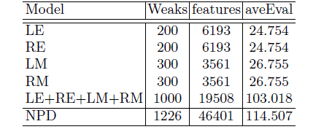
Model Complexity between AVC and NPD
Notes:
1. The complexity of the model is measured by aveEval, which means the average number of NPD features evaluated per detection window. The lower the value of aveEval, the faster the detector. For the
sake of speed, this index is important for the choices of our component models.
2. The aveEval in LE and LM are 24.754 and 26.755 respectively (See Table 1). So the total number of features per detection window that AVC has to evaluate is
103.018 with symmetric detection considered, which is faster than NPD holistic face detector implemented in NPD that has 46401 weak classiers and an aveEval of 114.507.
3. Another advantage of AVC is that storage memory required is low compared to CNN methods, which is crucial for real-world applications. The total model size of AVC is only
2.65MB, smaller compared to NPD (6.31MB) or a typical CNN model.

Slide 21
Conclusions
A novel face detector AVC
Addresses pose-variations and occlusions simultaneously in a single framework
Low complexity
2. Component-invariant mapping
3. Local to global aggregation strategy
Notes:
1. we proposed a new method called AVC highlighting component-based face detection, which addresses pose variations and occlusions simultanesously in a single framework with low complexity.
2. We show a consistent component denition which helps to achieve pose-invariant component detection.
3. To handle facial occlusions, we only detect visible facial components, and build a local to global aggregation strategy to detect the whole face adaptively

Slide 22
Face Detection by Aggregating Visible Components
Jiali Duan, Shengcai Liao, Xiaoyuan Guo, and Stan Z. Li
Center for Biometrics and Security Research
Institute of Automation, Chinese Academy of Sciences
Project Page: https://davidsonic.github.io/index/accv_2016.html

